Slide 1
Challenge Kick-off (Phase 1)
Next Generation Tech Booster Scholarship Program powered by Bertelsmann
December 12, 2024

Slide 2

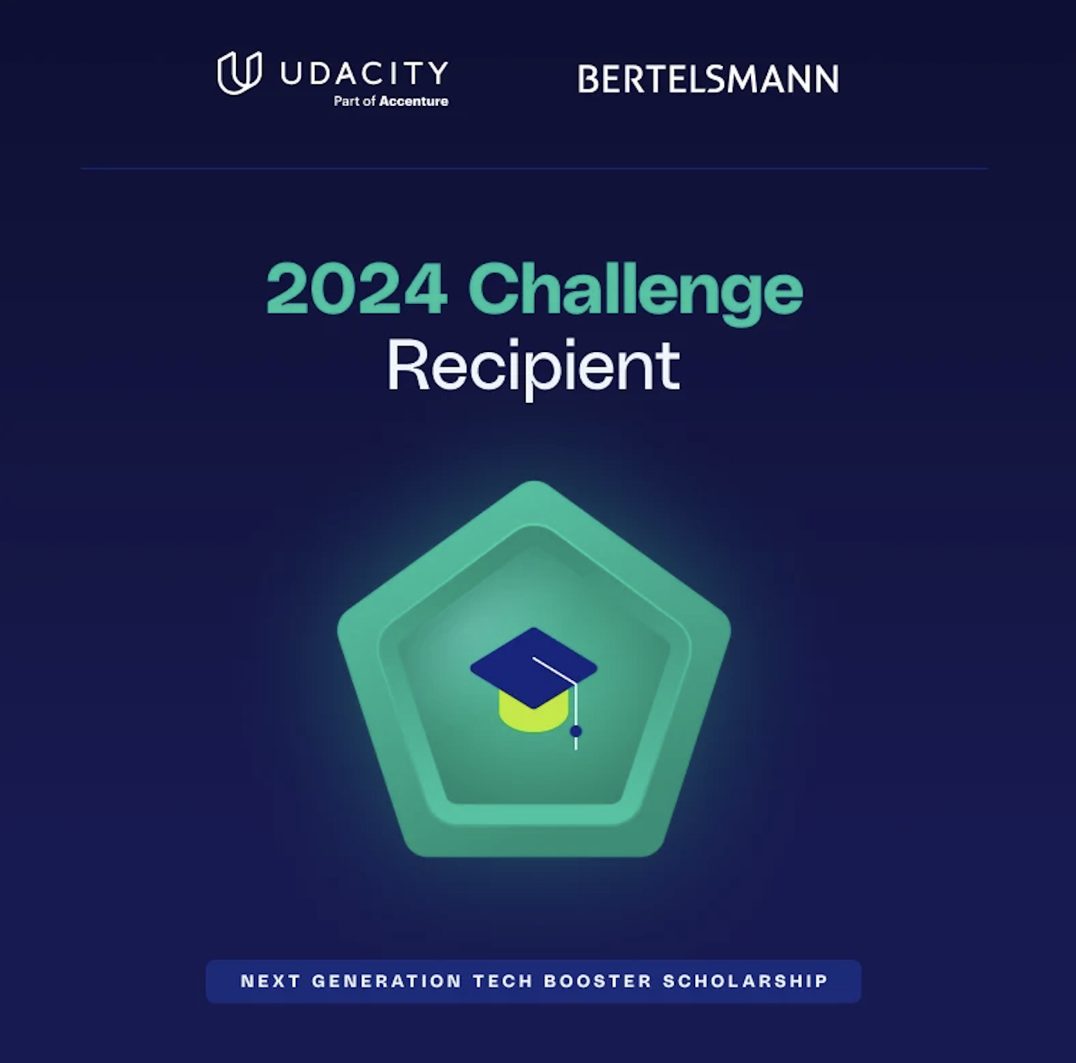

CONGRATULATIONS! 🎉
We’re excited to welcome you to the Next Generation Tech Booster Scholarship Program!

Slide 3

Housekeeping
All attendees are automatically muted
Please post your questions in the Next-Gen General Discussion space in the Community
If you have a similar question/statement that you see in the space, like it rather than reposting it!
In the community, we will always start with addressing questions with most likes
Recording & Slides will be shared in the Next Gen - Announcements after the session!

Slide 4

What is Udacity?
Program Overview
Getting Started with the Challenge Course
Udacity Community
Community Initiatives
Phase 1 Resources
TODAY’S
AGENDA

Slide 5









What is Udacity?
Founded in San Francisco in 2011 by Sebastian Thrun, the founder of Google X and the Self-Driving Car
Online education through Nanodegrees co-developed with top tech companies
“Silicon Valley University”
Currently, more than 90 Nanodegrees available (3 - 6 months programs).
205k Nanodegree alumni globally and 16.5 million users in more than 240 countries.
Global presence including presence in USA, India, Europe, and MENA.

Slide 6


What is Udacity’s Learning Model?
“UNIVERSITY”
FOR
INDUSTRY
MODEL
INDUSTRY CREATED TRAINING
REAL WORLD PROJECTS
MENTORSHIP & COACHING
CREATING TOP TALENT

Slide 7

Self-Reflection Time
What is your motivation?
What brought you here today?
What is keeping you motivated & inspired to succeed in this course?
What do you hope to get out of this Scholarship program?

Slide 8
Program Overview

Slide 9
How is the Scholarship Program structured?
500 top performers from Phase 1 will earn scholarship to their respective Nanodegree Program: Generative AI, Ethical Hacker or Digital Marketing
The full-scholarships will include project reviews, tutors and community support!
Phase 1
Phase 2
17,000 Learners
500 Nanodegree Seats
The first phase of this Scholarship provides an opportunity to learn the fundamentals of GenAI, Ethical Hacking and Digital Marketing. There are no projects involved and scholars are supported in the Community by community team, fellow learners & tutors

Slide 10

How Do I Move On to Phase 2?
Of the 17,000 Challenge Course recipients, 500 will be selected for the full Nanodegree program. You will be ‘eligible’ for Phase 2 selections, if you meet the following selection criteria:
100% completion of all Challenge coursework and materials, by the February 12th, 2025 deadline. This includes:
Lessons
Videos
Quizzes
Passing the Certification Assessment (CA) You will be able to take the CA as well as reattempt it (when you don’t pass it) from within your Challenge Course, until the Phase 1 deadline of Feb 12th, 2025 [11:59 PM CET] Reminder: The Challenge Course does not include any Projects

Slide 11
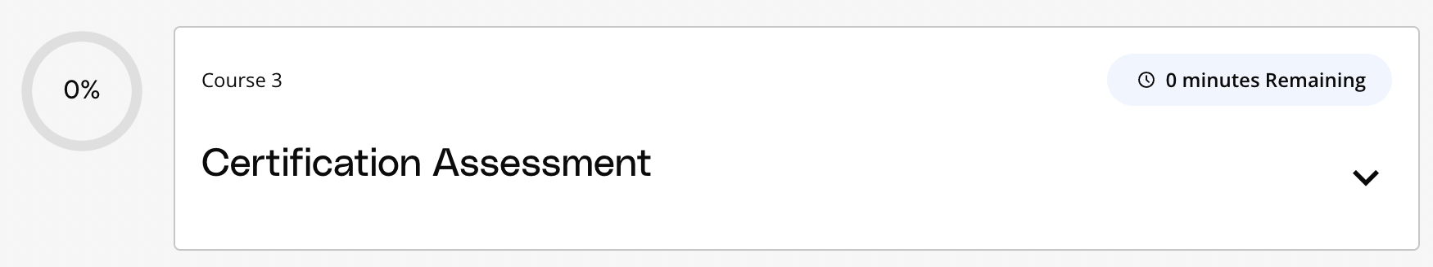
What is the Certification Assessment?
This assessment is one of the two main criteria used to determine Phase 2 selections
The test will consist of questions that will test you on your knowledge of concepts covered in the Challenge Course
Passing this assessment earns you a Certificate of Completion, passing this assessment is also key to be ‘eligible’ for Phase 2.
Find details about this test in the ‘Certification Assessment’ course inside your Challenge Course
Certification Assessment Course within the Challenge Course

Slide 12

Certification Assessment - Key Details
Completely online and will consist of MCQs
Is available to attempt inside your Challenge Course itself and you can attempt it until Phase 1 deadline
Duration of this assessment is 60 minutes. There will be a countdown timer on the screen.
You can’t pause the time, and once the timer reaches 0 seconds, the assessment will be automatically submitted.
You cannot skip any question or return to any previous one. So, take the time to thoughtfully answer each question while keeping track of the timer.
Certification Assessment FAQs

Slide 13
Certification Assessment - Key Details
You will receive a “Certificate of Completion” in your track if you pass the Certification Assessment
In case you do not pass the assessment, you will be able to reattempt the Certification Assessment, again until Feb 12, 2025
You cannot retake the assessment once you have passed it
Certification Assessment FAQs

Slide 14
Getting Started with the Challenge Course

Slide 15
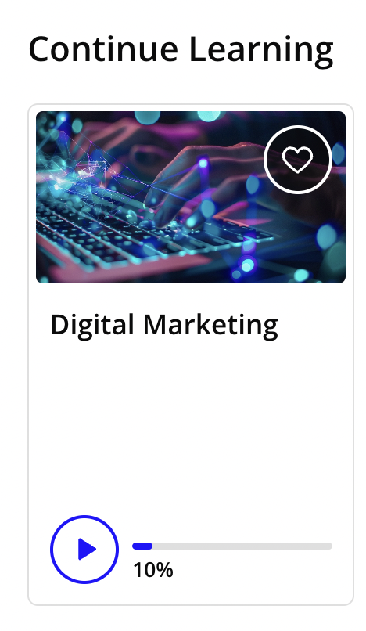
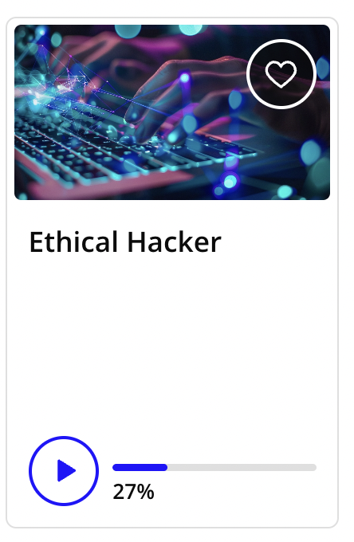
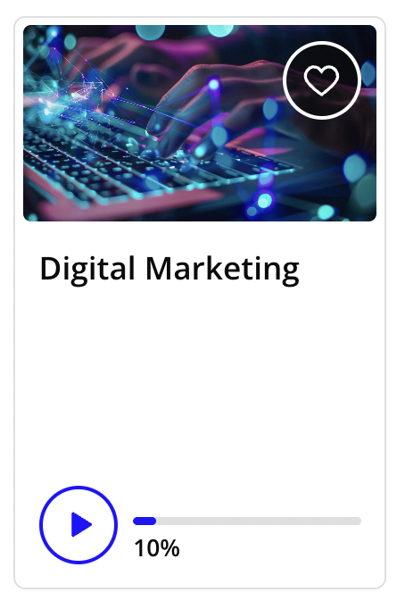
The Challenge Course is live in your Classroom!
Login to your Udacity Classroom & look for the Challenge Course under ‘Currently Learning’ tab
Click the Challenge Course card to begin!
If you have enrolled in multiple courses at Udacity - you will have to scroll through those courses to find your Challenge Course!

Slide 16
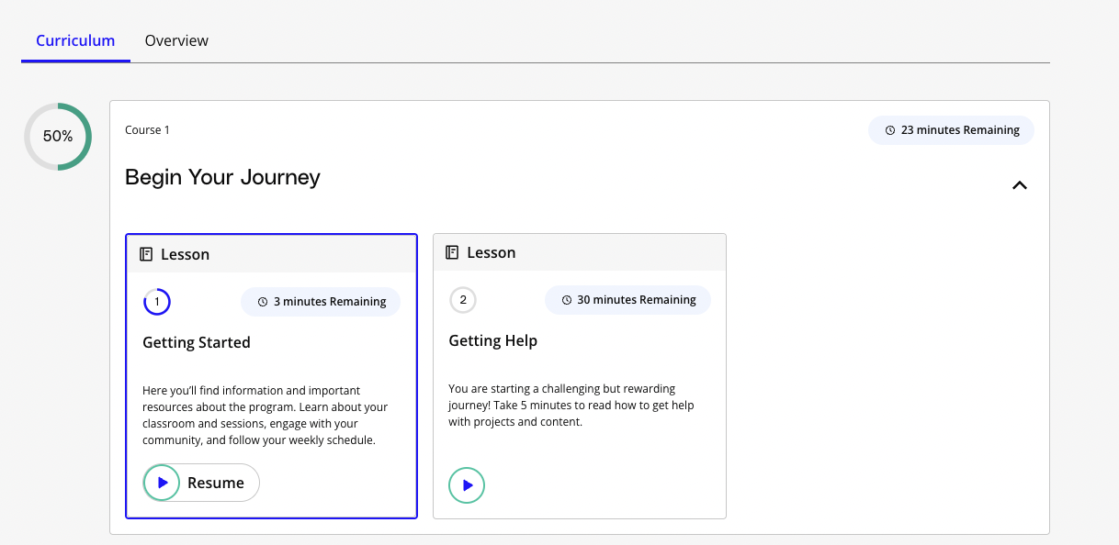
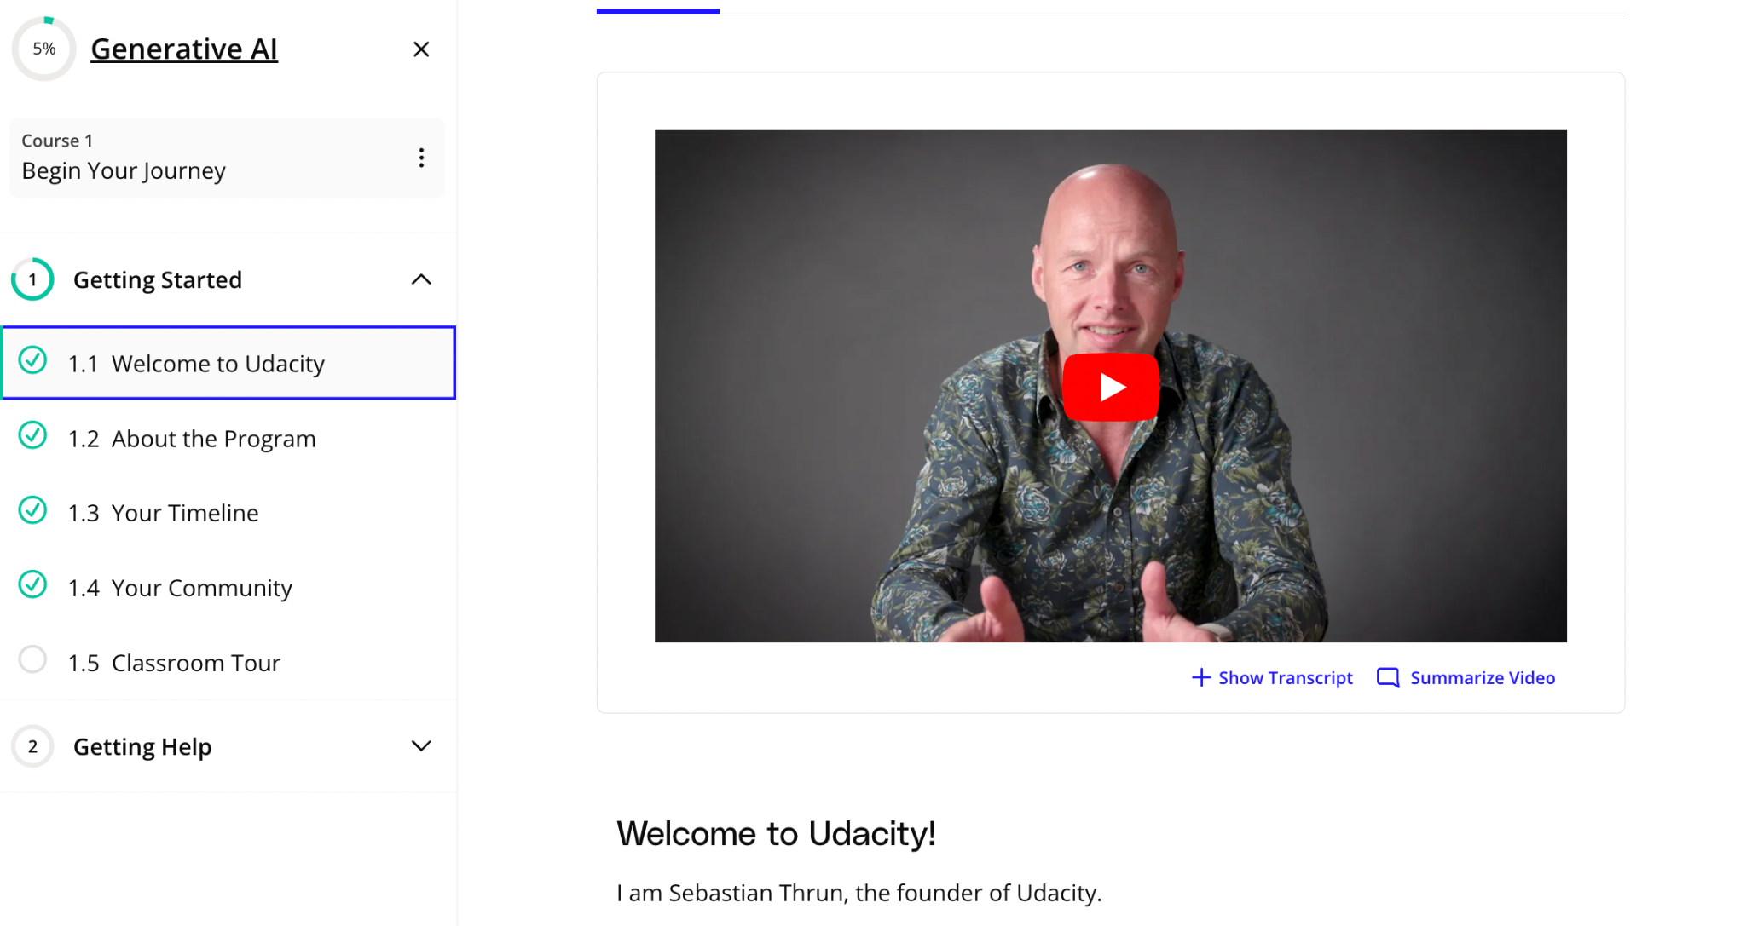
Once inside the course, begin your journey with the ‘Begin your Journey’ Course, then move on to the technical content in the second course!

Slide 17

Challenge Course Alert!
All accepted Challenge participants must start the program by Jan 6, 2025 to meet the ‘Active Participation Requirement’
To fulfill the active participant requirement:
Log into your Udacity account and click on your Challenge Course Card
Start the course by clicking into a minimum of one (1) Lesson and completing one Concept inside it.
⚠️ Both steps mentioned above must be done BEFORE Jan 6, 2025 @ 11:59 PM CET or you will be automatically unenrolled from the program

Slide 18

Ask for help!
You will be added to your Track-Specific spaces in community by Monday, Dec 16th, 2024 [GenAI | Ethical Hacker | Digital Marketing|
Whenever you have a technical doubt, you can reach out for support in these spaces.
Your fellow learners from the same track will be present here along with a technical expert (Tutor!)
Tutors will conduct weekly office-hours and will share resources in the track-space.
Stay tuned to meet your Tutors in the Community on Dec 16th!
Tips for Challenge Course success!

Slide 19
Spend 2-4 hours on the course each week
Consistent study sessions will help you retain information
Combat Imposter Syndrome
Acknowledge what you’re feeling & focus on what you’re able to do
Move away from negative self-talk
Think about what you may be missing out
Know that mistakes happen - it’s not because you’re not qualified!
Tips for Challenge Course success!

Slide 20

Key Things to Note
The full Scholarship program will run from March 5, 2025 to July 12, 2025
Phase 1 Results will be notified on March 3, 2025
Course Accessibility: 24/7
Program deadline: Feb 12, 2025
Course Completion: There is no clear indicator inside the classroom - we recommend a manual double check.
Watch all videos
Attempt all quizzes
Complete all exercises!
You must start the Challenge Course before Jan 5, 2024 to fulfil the Active Participation Criteria
You must pass the Certification Assessment by Phase 1 deadline of Feb 12, 2025

Slide 21
Udacity Community

Slide 22
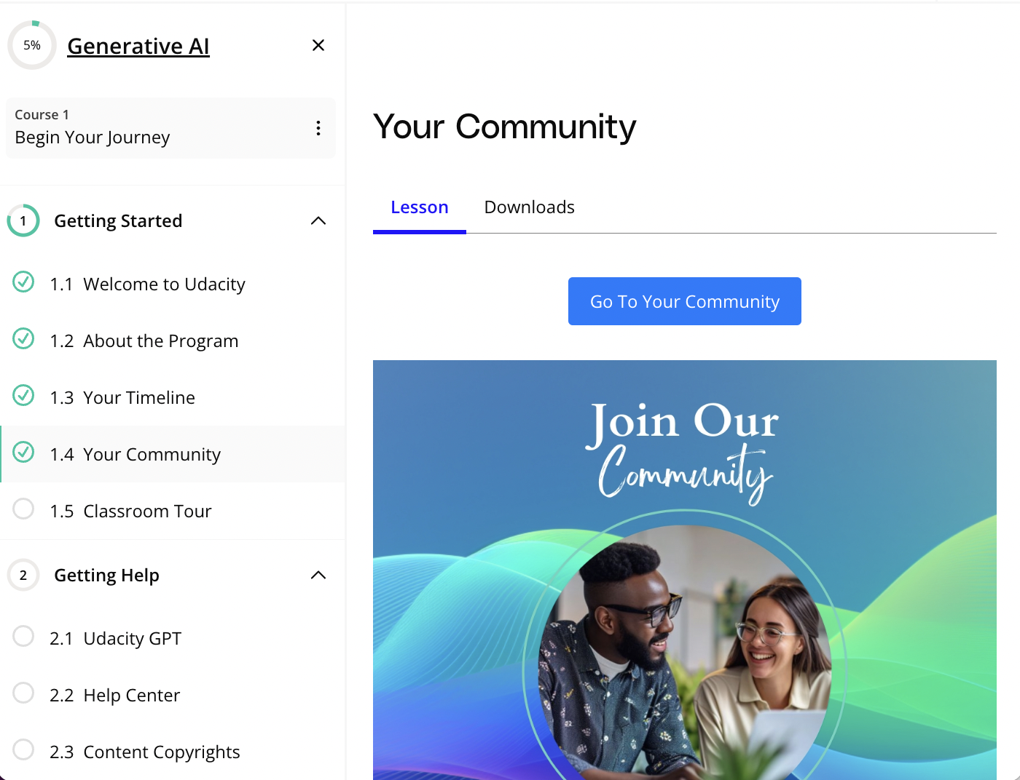

How to join Udacity Community?
Join Community via Classroom!
Step 1. Login to your Udacity Classroom. From the ‘Currently Learning’ tab, click into your Challenge Course card
Step 2. Expand the ’Begin Your Journey’’ course of your Nanodegree
Step 3. Click into the ‘Your Community’ lesson of the ‘Getting Started’’ module
Step 4. Click the ’Go to your Community’ button
Step 5. Next, you will find yourself inside the Udacity Community. Look for the ‘Next-Gen Tech Booster Scholarship’ spaces on the left-side bar and start exploring!

Slide 23
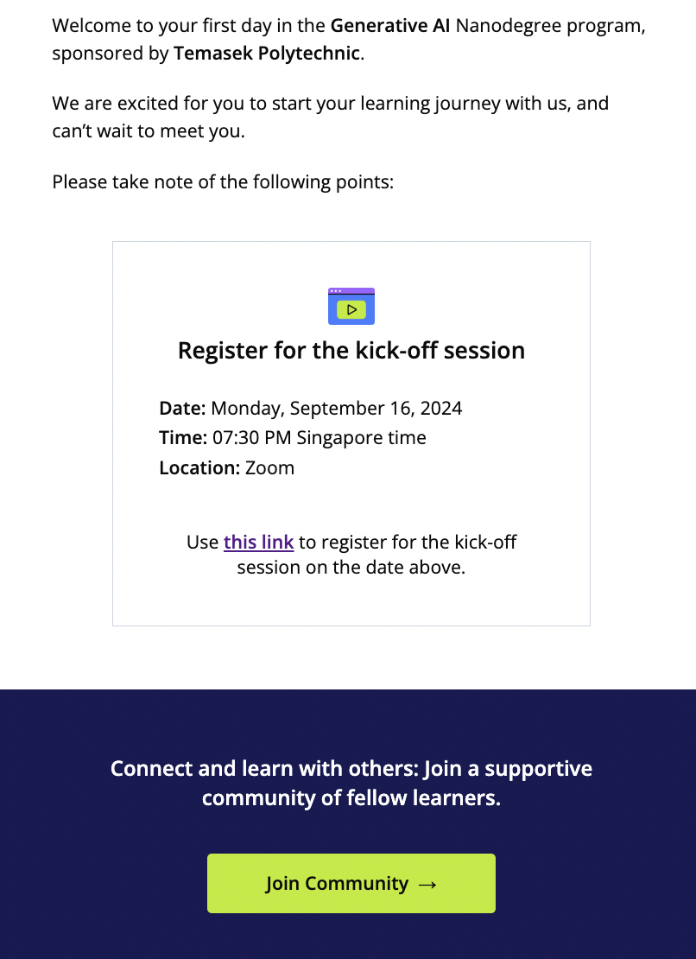
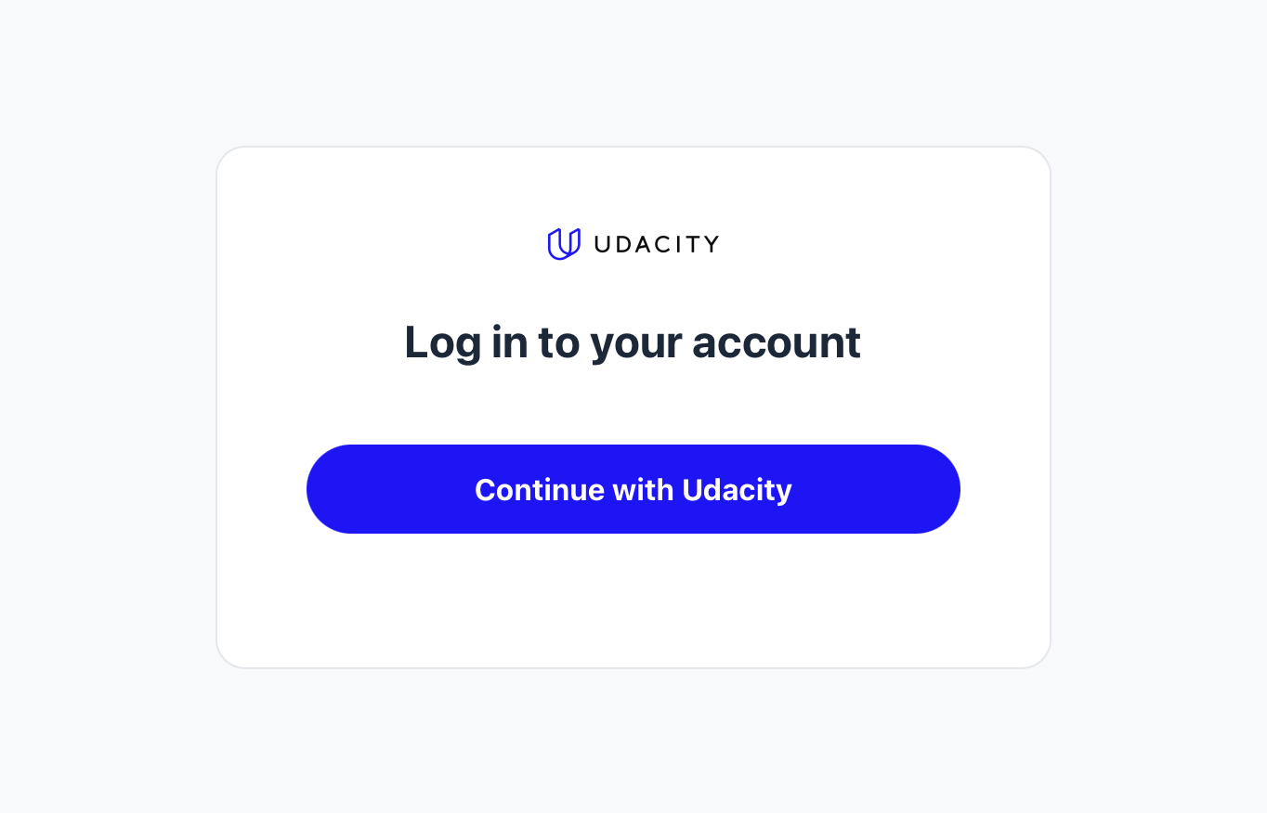
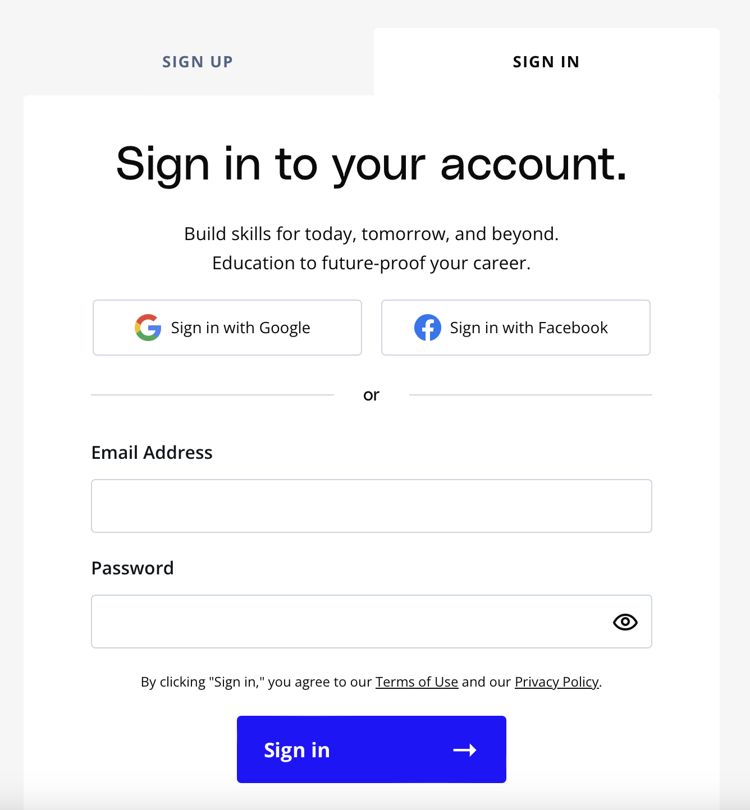
How to join Udacity Community?
Or Join Community via ‘Welcome Email’
Step 1. Look into your inbox for the ‘Welcome’ email from Udacity.
Step 2. Inside this email, you will find the button that says - ‘Join Community’. Click into this button!
Step 3. On the next screen, click on the ‘Continue with Udacity’ button.
Step 4. Next, sign-in into your Udacity Account. Once done, you will find yourselves inside the community!

Slide 24
5 Tips to jumpstart your Community Journey
1. Join the Program Community
2. Add a Profile Picture on Community
Find the link to join the community inside your Challenge Course or in the ‘Welcome’ email & sign in
Upload a profile picture to personalize your presence and connect better with fellow learners.
3. Update your Udacity Community Profile
4. Visit the Community Frequently
5. Go Mobile for Easy Access!
While updating your profile, make sure to fill the ‘Nanodegree Program’ field as this one is mandatory
Make it a habit to visit the community regularly to stay updated and connected
Download the Circle.so (Community) Mobile app for on-the-go access to your community.

Slide 25
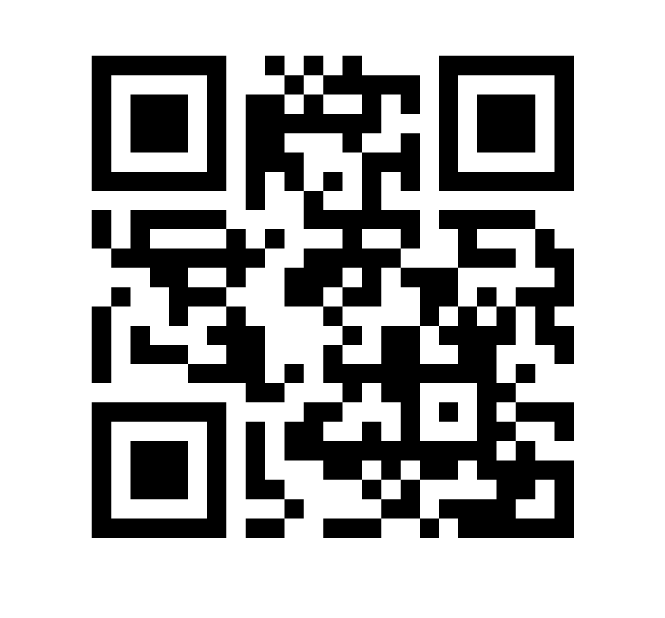

Download the Community App Now!
Let’s take a moment to scan the QR code and download the Community (Circle) App! 🤩
Login using the email address associated with your Udacity Account to access your program community

Slide 26
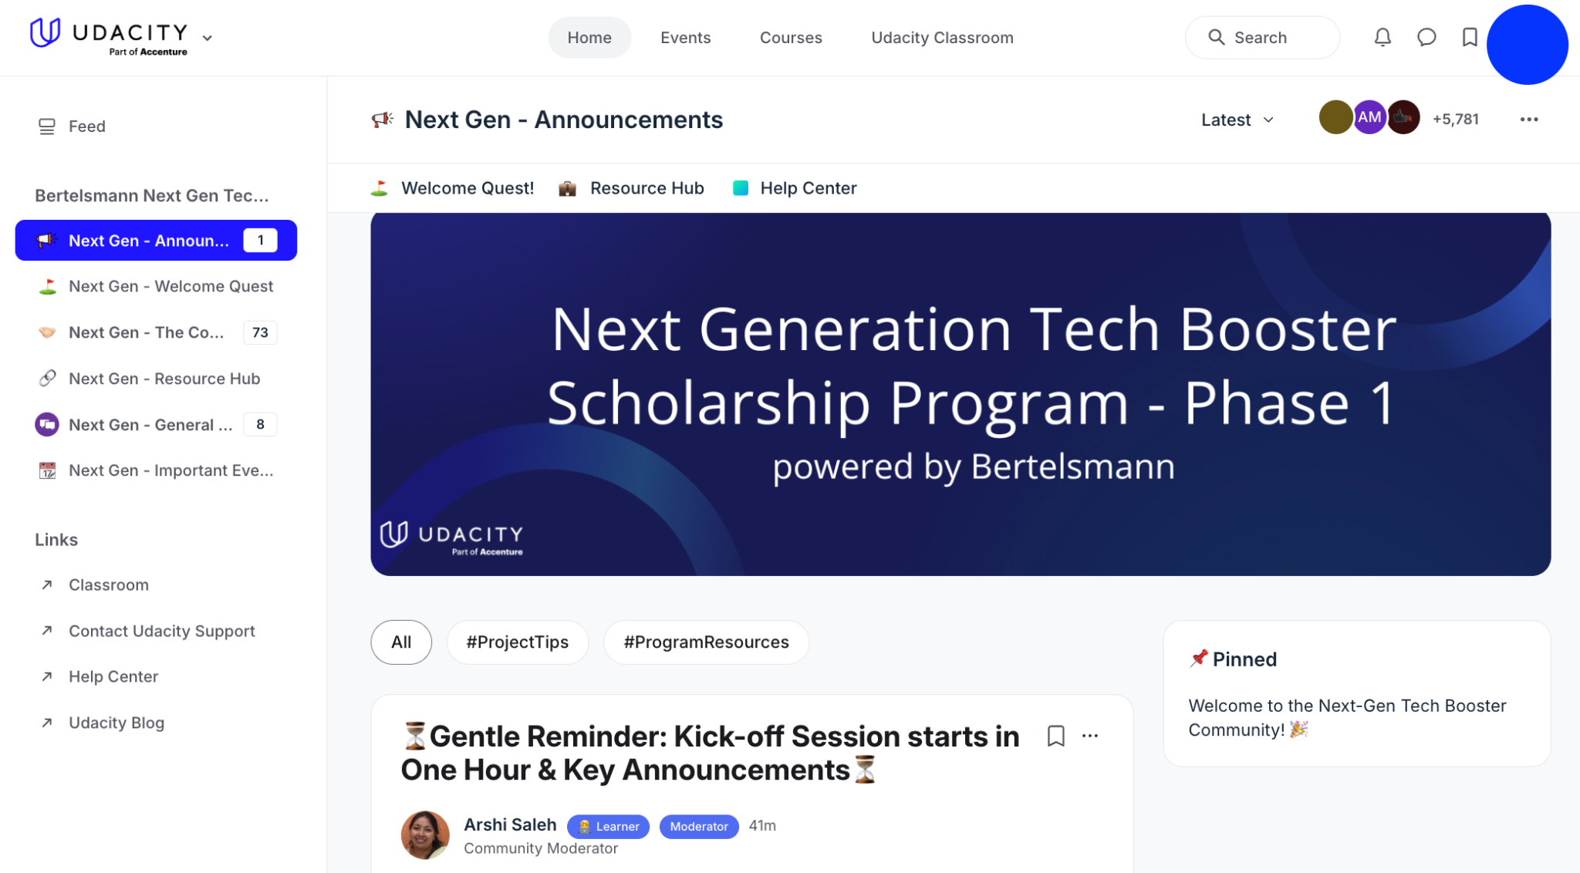
Udacity Community|A Snapshot
LEFT SIDEBAR
Navigate across different spaces effortlessly via this panel
IMPORTANT LINKS
Find links to critical resources bookmarked in the space header
PINNED POSTS BLOCK
Quickly access important information (eg. resources shared by mentors, updates etc.) via the pinned posts

Slide 27
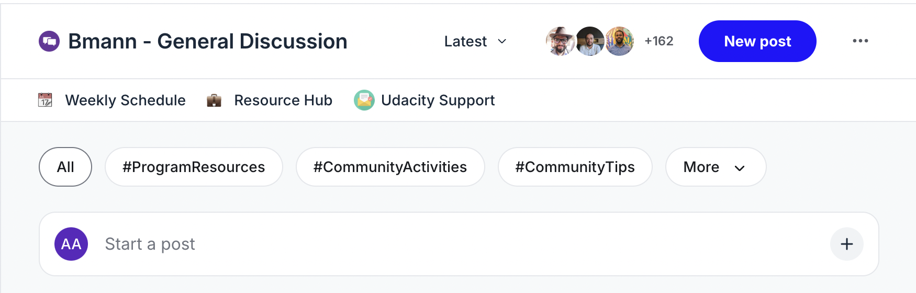
Udacity Community|A Snapshot
CLASSROOM BUTTON
Access Udacity Classroom from within the Community
EVENTS BUTTON
Get an overview of all upcoming important deadlines, community events and webinars
‘NEW POST’ BUTTON
Use the ‘New Post’ button to type a message and share it with the community!
TOPICS
Use the ‘Topics’ in spaces to swiftly filter discussions

Slide 28

Community Guidelines
Be Kind to Others
Behave professionally
Use welcoming & inclusive language
Be respectful of different viewpoints and experiences
Give as Much as You Take
Have an “Abundance Mindset”
Let go of your eye for competition and come to the community ready to help others succeed!
📌 Find our Code of Conduct here

Slide 29

4 Tips to Navigate the Community
Read messages from Community Managers posted in the Announcements space
Follow the spaces that are important to you. Don’t track every space and every conversation!
Use the right space. Reply in thread!
View our Community Guide on the Resource Hub
Take part in community activities!
How to be a successful student in Community

Slide 30
Community Initiatives

Slide 31
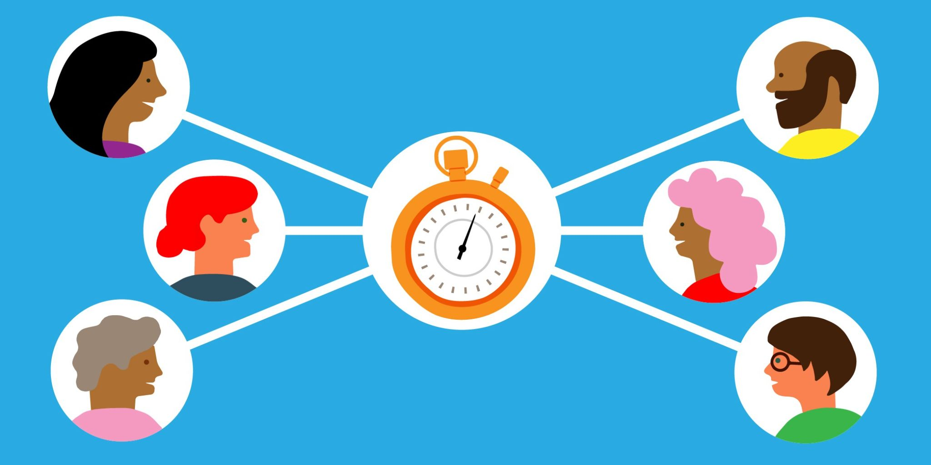
Daily Scrum
What it is: Prepare for a technical position through the daily scrum routine. Identify progress, goals, and blockers.
How to participate:
Join Sprint#1 of the Challenge for a 2 week Sprint, starts Mon, Dec 16!
Commit to a daily check in by posting your status to 3 questions:
What did I work on yesterday?
What will I work on today?
What issues are blocking my progress?

Slide 32

Student Council
What it is: Step up as a leader within your community and provide outstanding technical & moral support to help foster the community. All this while driving students to complete the Challenge Phase!
How to participate? 1. Apply for Student Council Roles! (applications opening on Mon, Jan 6) 2. Provide support and engage the community!

Slide 33
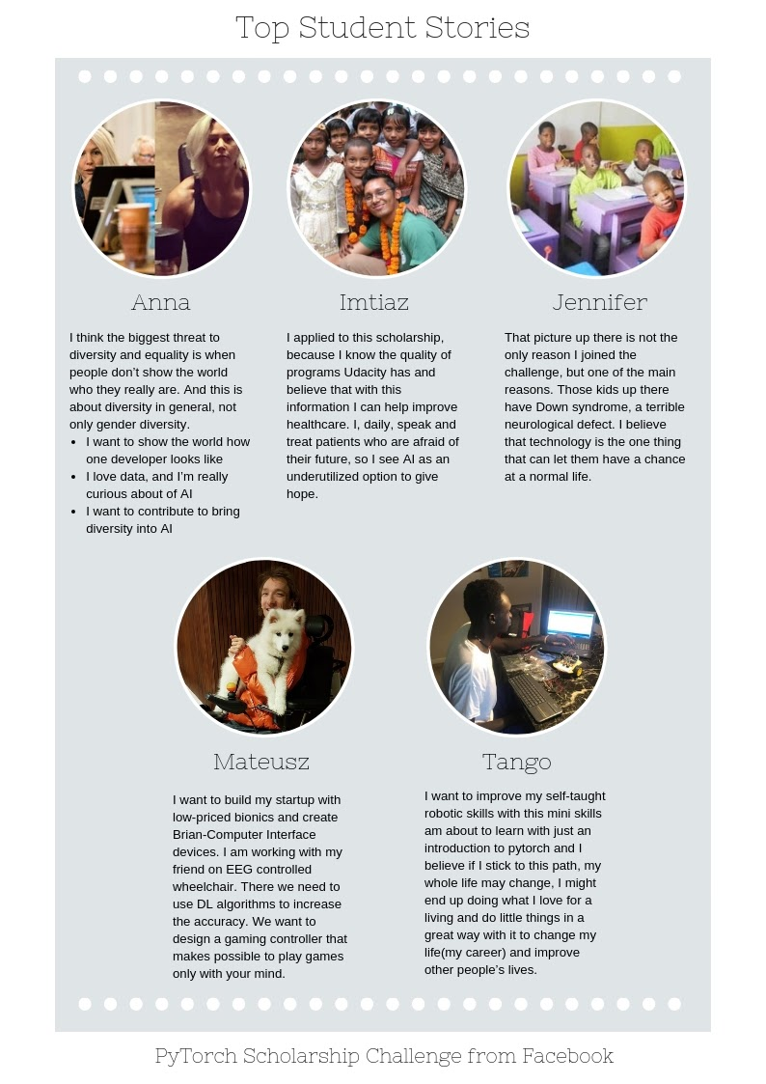
Student Story Challenge
What it is: Our most inspiring Challenge where we’ll ask you to share your personal journey! Finalists have a chance at being featured on the Udacity blog.
How to participate: (Starts Jan 20!)
Share your personal journey by writing your story!
Who were you in the past?
What led you to the Udacity Scholarship Program?
Who do you hope to be in the future as a result of this scholarship program?

Slide 34
Phase 1 Resources

Slide 35
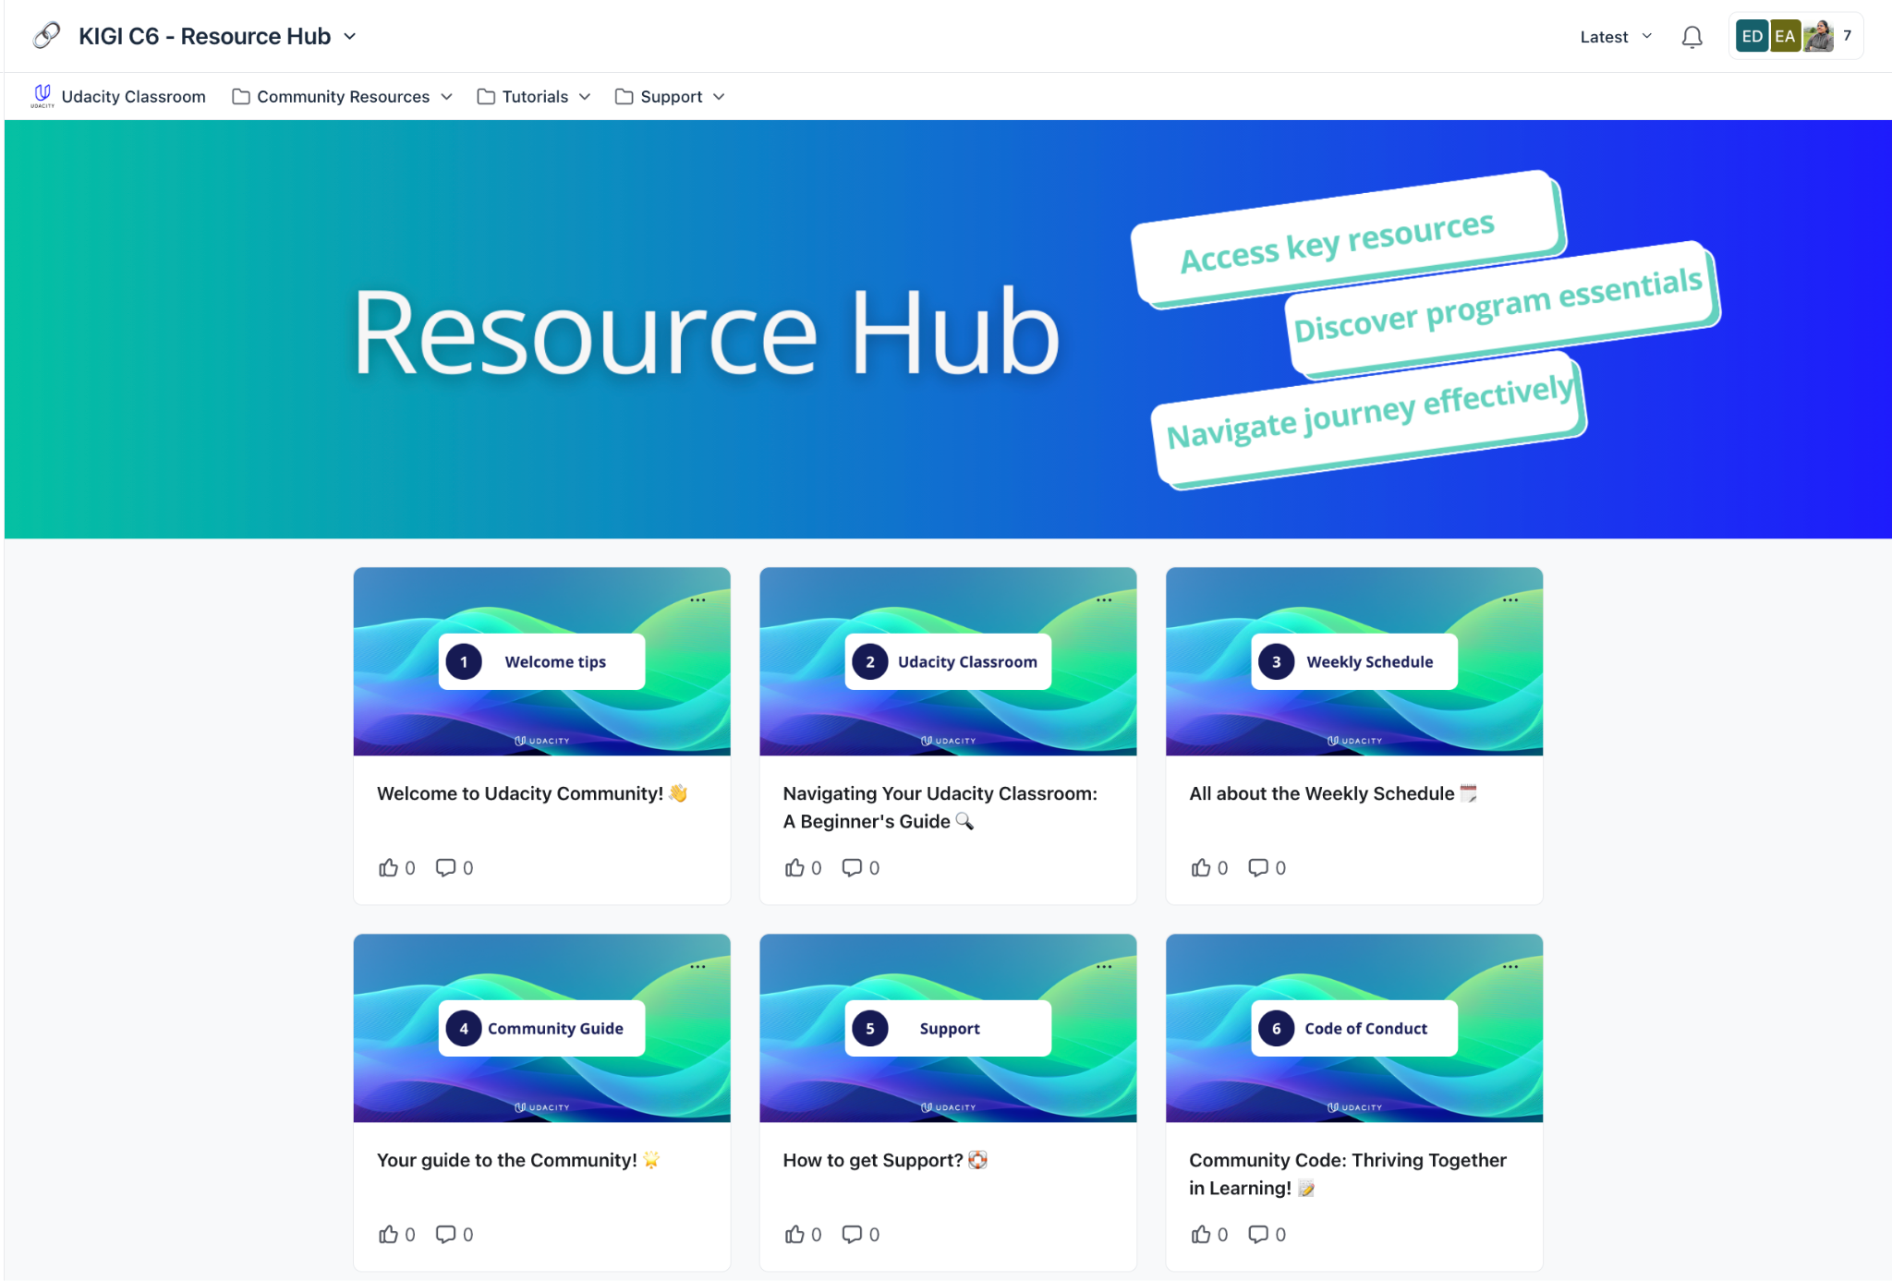
Resource Hub
Your one-stop shop to get any and all information about this program. If you have a program related question, you will most likely find the answer to it in the various posts on this space.
Explore the Resource Hub
You will have access to it once you have joined the Community

Slide 36
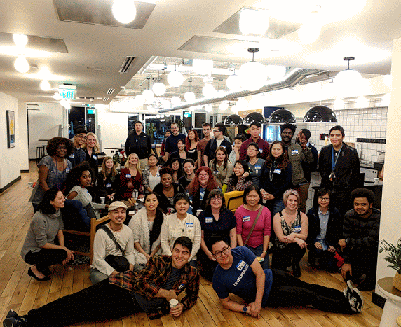
Your Classmates
This scholarship student community will become essential in helping you complete this Challenge.
“To me personally more than the content of the program the thing I liked the most is the community support. The person who doesn't know you and they may be miles apart of different time zone but they were there to help you/motivate you in your difficult time as friend or a mentor. When you feel that you cannot complete this course but he/she thinks that you can do it. That is the best thing that is with this community.”

Slide 37


Your Community Team
For Community & Program-related questions:
Refer to the Resource Hub!
Check out the ‘Announcements’ space for regular updates
Attend Ask Me Anything (AMA) Sessions in channel - or scroll back to read comments from the previous session
Palak Sadani @Palak Sadani
Arshi Saleh @Arshi.CommunityModerator
💡Tip: For urgent issues, please @mention us to ensure your question gets answered.

Slide 38

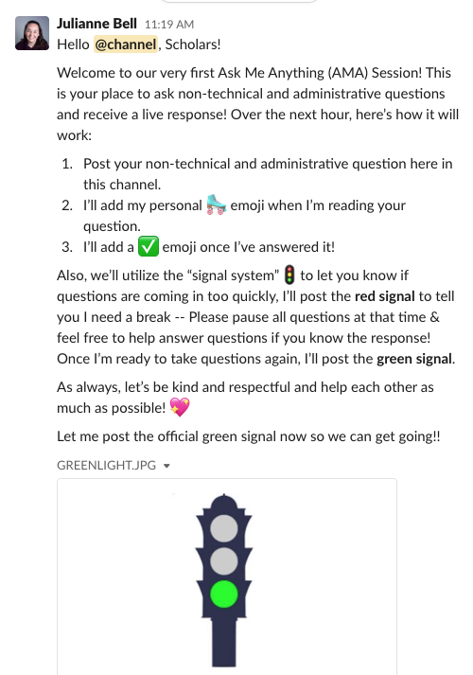
AMA Sessions
Ask Me Anything (AMA) Sessions are hour-long Q&A sessions conducted in ‘General Discussion’ space by your Community Team. Come here to get immediate answers to any non-technical, administrative questions regarding the program!
Upcoming AMAs:
Wed, Dec 18th @ 7 AM PT | 4 PM CET | 8:30 PM IST
Fri, Dec 20th @ 7 AM PT | 4 PM CET | 8:30 PM IST
Time Zone Converter

Slide 39
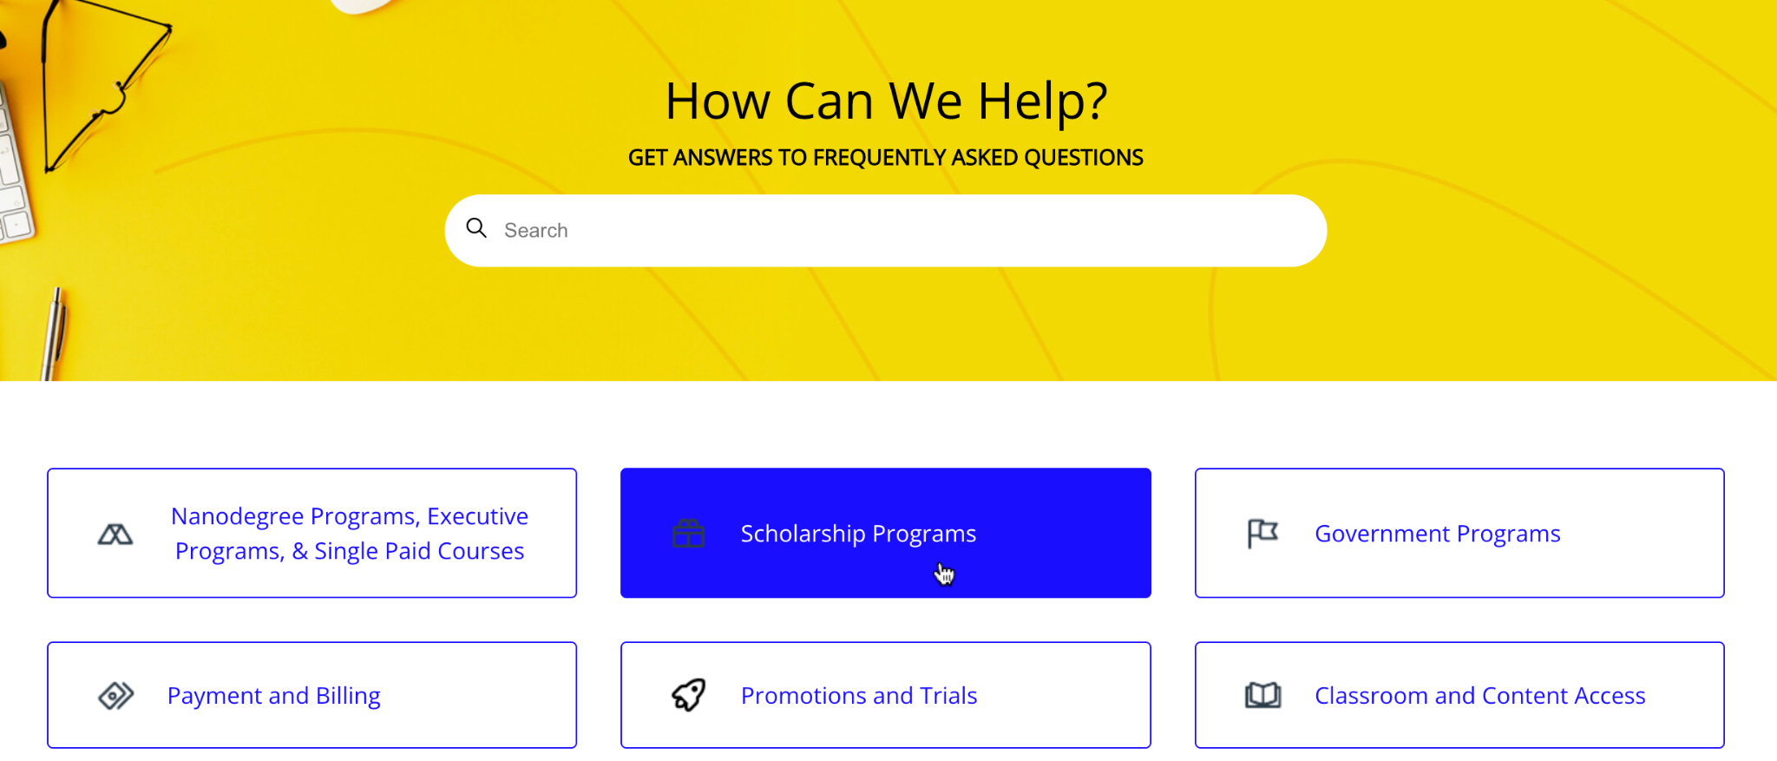
Your Support Team
For Account-related questions:
Step 1. Check out Udacity’s extensive FAQs Page (Help Center) to see if you can find your answer there! 🔎 Once inside FAQs, look into the category, ‘Scholarship Programs’ Step 2. Submit a Request to reach our Scholarship Support team. Examples:
- Change in registered email address
- Got accepted in the program but do not see course card in my classroom yet
Find your answers in FAQs > Scholarship Programs > Next Generation Tech Booster

Slide 40
Wrapping Up!

Slide 41
Wrapping up…
When does the Challenge Phase end?
The deadline for Phase 1 is February 12, 2025
How can I fulfil the Active Participation Requirement?
By starting the Challenge Course before January 6, 2025 Do I need to complete all the Challenge coursework?
Yes! You will need to complete 100% of your Challenge coursework by February 12, 2025 to be considered for Phase 2.
Do I have to take the Certification Assessment?
Yes! This Assessment test is one of the selection criteria used to determine Phase 2 selections. The Assessment lies inside your Challenge Course and you can attempt it until the Phase 1 deadline of February 12, 2025

Slide 42
And there’s more…
Will I receive a Certificate of Completion? Yes. Once you pass the Certification Assessment, you will receive a ‘Certificate of Completion’ of your Challenge Course.
Will I receive a badge for completing the Challenge Course? Yes. You will receive a completion badge once you complete 100% of the Challenge Course content Will I be able to access the course past Feb 12, 2025? All students will be unenrolled from their Challenge Course once the February 12th deadline has passed.
Will Phase 2 seats be awarded proportionally?
Udacity’s goal is to award seats to students in each track as evenly as possible based on the volume of eligible scholars per track.

Slide 43
Thank you!

